Slide 1
Random n-Polygon
Joshua Sarver

Slide 2
The Problem
Create a random polygon with n sides
Current solution is O(n^2)

Slide 3
Solution
Use quad-trees
Often used in video games for collision detection
Reduces the amount of objects that need checked for collision
Recursively breaks bounding boxes into quadrants
Objects are then sorted by quadrant
To check for collision only check everything inside the current quadrant
Each node bounding box which consists of quadrants
Each parent has four children

Slide 4
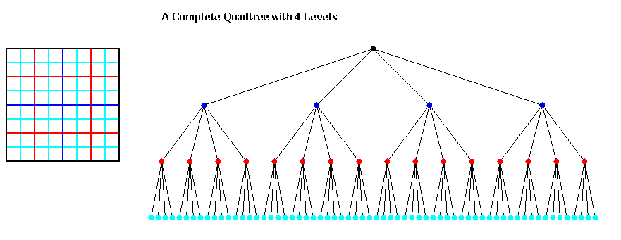
Example
https://www.youtube.com/watch?v=fuexOsLOfl0

Slide 5
Verification
To ensure the quadtree is working properly, after a solution is generated the brute-force method is ran on all lines to check for collision
If a problem is found it is marked in red
Verification does not count against runtime or number of checks
The program consistently passes verification

Slide 6
Results
Quadtree vs. bruteforce (n=1000)
99% reduction in collision checks
91% reduction in running time
Quadtree vs. Whitfield (n=1000)
80% reduction in running time
Collision checking now takes < O(2n)
One check for each of the two new lines
Each lines could be in a quadrant that requires all lines to be checked (very unlikely)

Slide 7
Results
Smaller n’s
Saw smaller improvements with quadtree
Quadtree complexity becomes negligible as n becomes large
Limiting Line Length
Between [1,100]
92% reduction in runtime for quadtree
73% reduction in runtime for brute-force

Slide 8
Future Work
Dynamically limit line-length vs. n vs. area for optimal results
More area means less possible collisions
Shorter line length means less possible collisions
Larger n’s probably require shorter line length
Optimize quad-tree
Don’t use bounding boxes on lines
Don’t reset quad-tree every time a new line is added
Don’t use Javascript

Slide 9
Sources
Quadtree
http://blog.sklambert.com/html5-canvas-game-2d-collision-detection/
Line intersection
https://jsfiddle.net/justin_c_rounds/Gd2S2/
Dr. Whitfield’s research

Slide 10
My Game
github.com/joshS314159/Maze-Escape

